Slide 1
Edge Advanced Mediation
Service Callout & Mashups

Slide 2
Service Callout
The Service Callout policy lets you call to another service from your API proxy flow.
Can be used for
External use case - call 3rd party APIs
Internal use case - call a proxy in the same organization and environment
The policy supports requests over HTTP and HTTPS. Also has Request and Response elements which is separate from the actual proxy request and response
A callout is typically used with two other policies: Assign Message (for the service callout request) and Extract Variables (to extract the service callout response)

Slide 3
Service Callout (cont’d)
Target connection configurations supported in Service Callout:
HTTPTargetConnection (external)
URL
Target Server (Load Balancer)
Target Server with SSLInfo
LocalTargetConnection (internal)
APIProxy (proxy in the same organization and environment)
Proxy endpoint (proxy endpoint that should be the target of calls)
Path (path to the endpoint that is being targeted)

Slide 4
Creating a Mashup

Slide 5
Mashing up the Responses
Strategies for Mashups
Assign Message (simple, most constrictive)
Extract Variables, Assign Message (simple, constrictive)
JavaScript (flexible, complex)
Java (flexible, complex)
XSLT (flexible, complex)
Choose a format that works for you!!

Slide 6
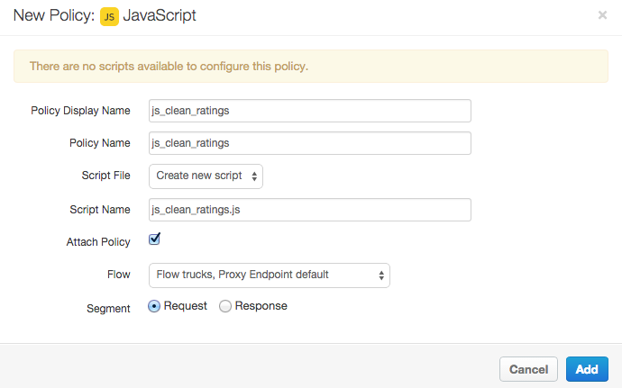
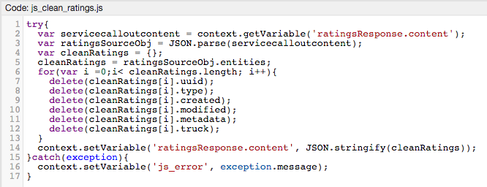
A Mashed Up Response Sure but…..
One method of cleansing your JSON of unwanted fields is to use the JavaScript policy, or you could extract out the fields you want with an Extract Variables policy, or a combination of both.

Slide 7
THANK YOU

